Slide 1

Academic Year 2025 - 26 S6 MINI PROJECT - II Final Review
GREEN CAMPUS PERFORMANCE DASHBOARD
BIP PROJECT ID
2026MIN1571
CATERGORY
INTERNAL
MEMBER
VISHWA S (7376232IT280)
GUIDE
Prof. SENTHILNATHAN S
Associate Professor
Department of Information Technology

Slide 2
AIM & OBJECTIVES OF THE PROJECT (Problem Statement)
Aim
To develop a Green Campus Performance Dashboard for centralized monitoring, analysis, and evaluation of environmental parameters such as energy, water, waste, and carbon emissions.
Problem Statement
The absence of a centralized and efficient system makes it difficult to monitor, analyze, and manage campus environmental data, leading to poor sustainability awareness and decision-making.
Objectives
To develop a centralized dashboard for monitoring environmental parameters.
To provide data visualization and comparison using charts and graphs.
To implement secure role-based access with admin data management features.
To compare current and previous data for analysis.
To evaluate sustainability using Green Score and alert mechanisms.
To provide a Contact Us module for user-admin communication.

Slide 3
Sl.No. | Journal Paper Title with Author | Works carried out ( with details of Methods/ Materials/ Software/ Algorithms / fabrication / techniques/ components used ) | Information gathered relevant to your project
1 | A. Raj, S. Kumar, "Smart Campus Monitoring System Using IoT," IJERT, vol.9, no.5, 2020. | IoT sensors, microcontrollers, real-time data collection, cloud storage, data monitoring techniques | IoT-based monitoring improved real-time tracking of environmental parameters. Supports automated data collection idea for future enhancement.
2 | S. Patel, M. Shah, "Web-Based Environmental Monitoring Dashboard," IJCA, vol.182, no.10, 2018. | Web technologies (HTML, JS), dashboard design, charts (bar/pie), database integration | Dashboard visualization improved data understanding by 40%. Supports UI design and graph usage in project.
3 | R. Verma, P. Singh, "Sustainable Campus Management System," Intl. Journal of Smart Systems, 2021. | Integrated modules (energy, water, waste), database systems, reporting tools, analysis techniques | Multi-parameter monitoring improved sustainability tracking. Inspired integration of all modules in one system.
4 | D. Ferraiolo, R. Sandhu, "Role-Based Access Control Models," IEEE Security, 2001. | RBAC algorithms, authentication systems, user role management, access control mechanisms | Role-based access improved system security. Used for admin-user login control in project.
5 | S. Few, "Data Visualization for Decision Support Systems," Analytics Press, 2006. | Data visualization techniques, dashboard design, graphs, analytical tools | Visual dashboards improved decision-making efficiency. Supports use of charts and green score visualization.

Slide 4
Sl.No. | References ( Journal Papers Only) | Works carried out ( with details of Methods/ Materials/ Software/ Algorithms / fabrication / techniques/ components used ) | Information gathered relevant to your project
6 | K. Chodorow, "MongoDB: The Definitive Guide," O’Reilly, 2019. | NoSQL database, document-based storage, indexing, flexible schema, MongoDB | MongoDB enables efficient handling of large and dynamic data. Supports database design of the project.
7 | J. Power, "Decision Support Systems: Concepts and Resources," Business Expert Press, 2013. | Decision support systems, data analysis, reporting tools, visualization techniques | DSS improves decision-making using data insights. Supports dashboard-based analysis in the system.
8 | A. Murugesan, "Harnessing Green IT: Principles and Practices," IT Professional, IEEE, 2008. | Green computing, energy optimization, sustainability techniques, resource management | Green IT concepts promote eco-friendly practices. Supports sustainability goals of the project.
9 | T. Erl, "Cloud Computing: Concepts, Technology & Architecture," Prentice Hall, 2013. | Cloud computing, distributed systems, APIs, data storage, scalability techniques | Cloud integration improves scalability and accessibility. Useful for future system enhancements.
10 | B. Shneiderman, "Designing the User Interface," Pearson, 2016. | UI/UX design principles, human-computer interaction, usability techniques, interface design | Good UI design improves user experience and interaction. Supports frontend design of the dashboard.

Slide 5
SCOPE OF THE PROJECT
The system provides a centralized dashboard to monitor environmental parameters such as energy, water, waste, and carbon emissions in a single platform, improving data accessibility and management.
It enables data visualization and analysis using graphs and charts, allowing users to easily understand trends, compare weekly and monthly data, and make informed decisions.
The project includes role-based access control, where the admin can manage data (add, edit, delete) and users can view information and interact through the Contact Us feature.
The system calculates a Green Score based on multiple parameters, helping to evaluate overall campus sustainability performance in a simplified and measurable way.
The scope can be extended to include future enhancements such as real-time data collection using IoT devices, cloud integration, and advanced analytics for better performance and scalability.
The system supports user interaction and feedback, allowing users to raise queries or issues through the Contact Us module, which helps improve communication and enhances overall system usability.

Slide 6
NEED FOR THE CURRENT STUDY
There is a need for a centralized system to monitor environmental parameters like energy, water, waste, and carbon, as existing methods are mostly manual and scattered.
Current systems lack effective data visualization, making it difficult to understand and analyze environmental performance easily.
There is limited awareness about sustainability practices among users, which requires a system that clearly presents environmental data and insights.
Institutions require a data-driven approach to identify inefficiencies and take informed decisions for better resource management.
Existing solutions do not provide a combined performance metric, creating a need for a unified indicator like the Green Score.
There is a growing demand for user-friendly and accessible platforms that support both administrators and users in monitoring and improving campus sustainability.

Slide 7
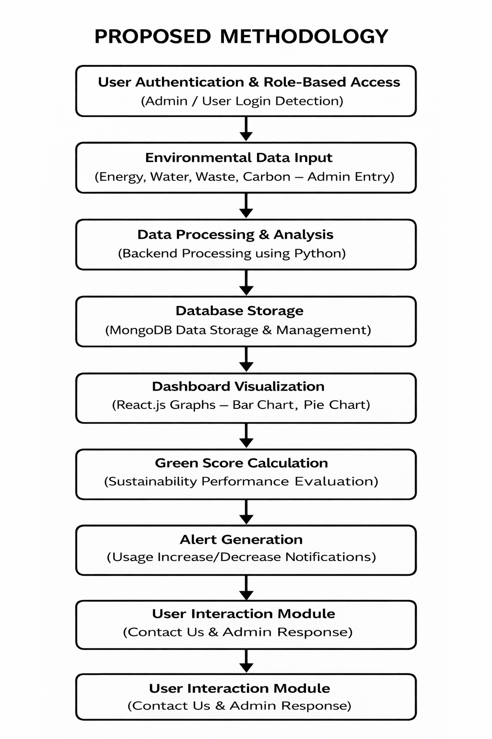
PROPOSED METHODOLOGY ( Flow Chart)

Slide 8
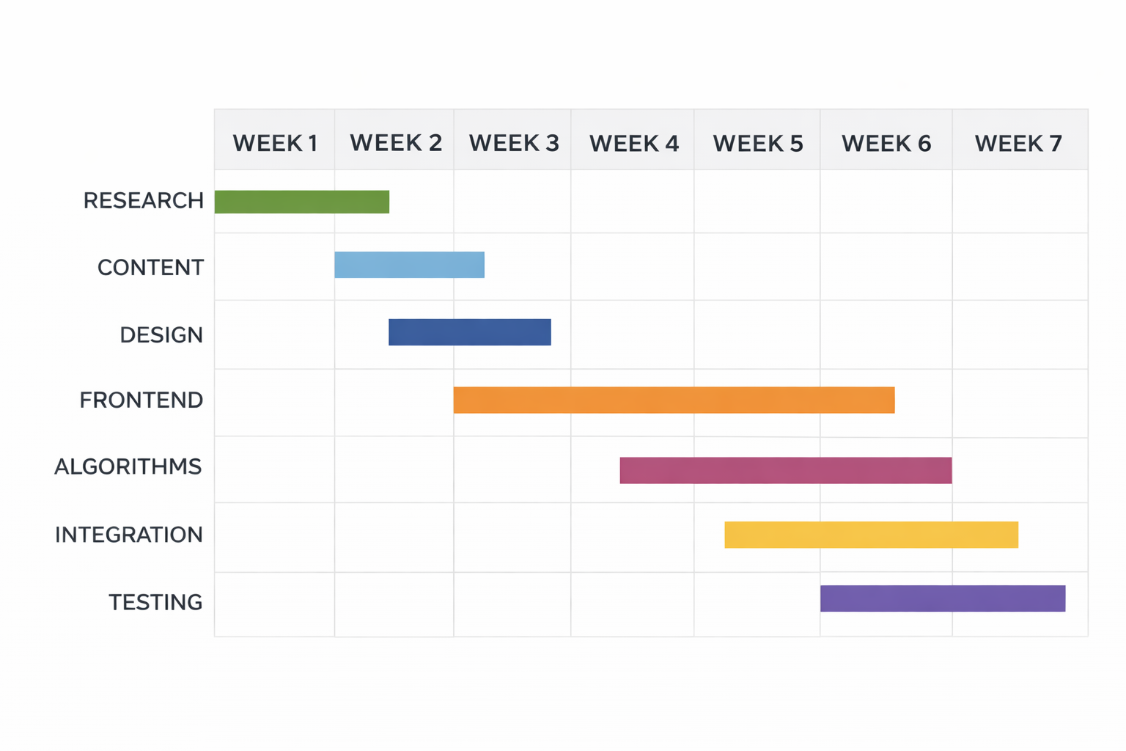
PROPOSED METHODOLOGY ( Gantt Chart)

Slide 9
CHOICE OF COMPONENTS USED FOR PROJECT DEVELOPMENT
Frontend
React.js – Component-based UI framework used to design interactive dashboards for admin and user modules.
Recharts – Data visualization library used to display environmental data through bar charts, pie charts, and comparison graphs.
Axios – HTTP client used for API communication between React frontend and Flask backend.
Backend
Python with Flask – Lightweight backend framework used to develop RESTful APIs, handle business logic, and manage system operations.
Data Processing Modules – Implements logic for data comparison, alert generation, and Green Score calculation based on environmental parameters.
REST API Integration – Enables communication between frontend and database for fetching, updating, and managing data.
Database
MongoDB with Mongoose / PyMongo – NoSQL database used to store environmental data such as energy, water, waste, carbon, and user messages.

Slide 10
DESIGNS (SOFTWARE ARCHITECTURE)
Three-Tier Web Architecture
Presentation Layer (Frontend)
React.js renders role-based dashboards for admin and user, Recharts provides data visualization through charts and graphs, and Axios manages API communication between frontend and backend.
Application Layer (Backend)
Python with Flask processes requests, handles business logic such as data comparison, alert generation, and Green Score calculation, and provides REST APIs for system operations.
Database Layer
MongoDB stores environmental data (energy, water, waste, carbon) and user interactions using flexible document-based storage for efficient retrieval and scalability.
Analytics & Scoring Logic
Backend computes Green Score and performs comparative analysis of current and previous data to generate alerts and support sustainability decision-making.

Slide 11
ANALYSIS OF RESULTS AND DISCUSSION
Overall Dashboard
Displays combined environmental data (energy, water, waste, carbon) using charts and summary cards. Provides a clear overview of monthly performance along with pie charts and alert messages for quick decision-making.
Energy Dashboard
Shows weekly energy consumption using bar charts and compares it with previous month values. Helps in identifying usage patterns and detecting increases or decreases in energy consumption.
Water Dashboard
Visualizes weekly water usage data and highlights variations through graphical representation. Supports analysis of consumption trends and efficient water resource management.
Waste & Carbon Dashboard
Displays waste generation and carbon emission data with comparison charts. Helps in understanding environmental impact and identifying areas for improvement in sustainability.
Green Score Dashboard
Calculates and presents an overall sustainability score based on multiple environmental parameters. Provides a simplified evaluation metric to track performance improvements over time.

Slide 12
CONCLUSION
The Green Campus Performance Dashboard successfully delivers a centralized platform that transforms scattered environmental data into meaningful insights through interactive dashboards and visualizations.
The integration of React.js, Flask, and MongoDB enables efficient data processing and real-time visualization of energy, water, waste, and carbon parameters, helping users easily identify trends and performance changes.
The Green Score feature simplifies sustainability evaluation by combining multiple environmental metrics into a single indicator, making it easier for administrators to monitor overall campus performance.
The role-based access system ensures secure data handling, while the alert mechanism helps in identifying abnormal usage patterns and supports timely decision-making for better resource management.
The modular web-based architecture provides flexibility, ease of development, and scalability, making the system suitable for extension to larger campuses or smart city applications.
Future Work
Future enhancements include integration of IoT sensors for real-time data collection, mobile application support for better accessibility, advanced analytics for predictive insights, cloud integration for scalability, and automated notification systems for improved user engagement.

Slide 13
PENDING WORKS AND PLAN FOR COMPLETION
Integration of real-time data collection using IoT sensors to replace manual data entry and improve accuracy of environmental monitoring.
Enhancement of data visualization features by adding more interactive graphs and advanced comparison tools for better analysis.
Implementation of mobile application support to provide easy access to the dashboard for users and administrators anytime.
Deployment and testing of the system on a cloud platform to ensure scalability, performance optimization, and real-world usability.

Slide 14
Architecture Comparison Summary A three-tier web architecture (React + Flask + MongoDB) was selected over complex microservices architecture, as it is optimal for the project’s limited scope, small dataset, and academic timeline while ensuring simplicity, maintainability, and efficient development.
Tech Stack Comparison Summary The React–Flask–MongoDB stack was chosen over traditional stacks like LAMP due to React’s dynamic UI capabilities, Flask’s lightweight and flexible backend processing, and MongoDB’s ability to handle unstructured environmental data efficiently, enabling seamless integration and faster development.
System Performance Metrics Dashboard data loading and visualization occur in real-time with minimal delay; Green Score calculation and alert generation are processed instantly at the backend, and MongoDB operations ensure fast data retrieval and updates for smooth system performance.
Scalability The system is designed to scale from a single campus to multiple institutions without major architectural changes, supported by MongoDB scalability, modular design, and API-based communication, allowing future expansion with IoT integration and cloud deployment.
Any Other Relevant Details

Slide 15
REFERENCES ( Journal Papers/ Books / Website in IEEE Format )
Journal Papers
[1] A. Raj, S. Kumar, "Smart Campus Monitoring System Using IoT," International Journal of Engineering Research & Technology (IJERT), vol. 9, no. 5, pp. 120-126, 2020.
[2] S. Patel, M. Shah, "Web-Based Environmental Monitoring Dashboard," International Journal of Computer Applications (IJCA), vol. 182, no. 10, pp. 15-22, 2018.
[3] R. Verma, P. Singh, "Design of Sustainable Campus Management System," International Journal of Smart Systems, vol. 6, no. 2, pp. 45-53, 2021.
[4] D. Ferraiolo, R. Sandhu, "Role-Based Access Control Models," IEEE Transactions on Information and System Security, vol. 4, no. 3, pp. 224-274, 2001.
[5] S. Few, "Data Visualization Techniques for Decision Support Systems," Analytics Press, pp. 1-50, 2006.
[6] K. Chodorow, "MongoDB: The Definitive Guide," O’Reilly Media, 3rd Edition, 2019.

Slide 16
THANK YOU

